Slide 1
ONLINE COURSE REGISTRATION
ROOSEVELT PILOT PROGRAM
APRIL 2015

Slide 2
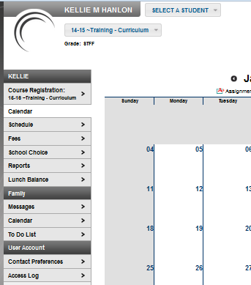
STUDENT LOG IN
Students should log into their student portal account
Once online course registration has been opened, the students will be able to see a Course Registration link for the 15-16 school year.
To begin course selection, click on the Course Registration link.

Slide 3
COURSE SEARCH
Once the link has been clicked, the students will be click on course search to begin selecting courses.

Slide 4
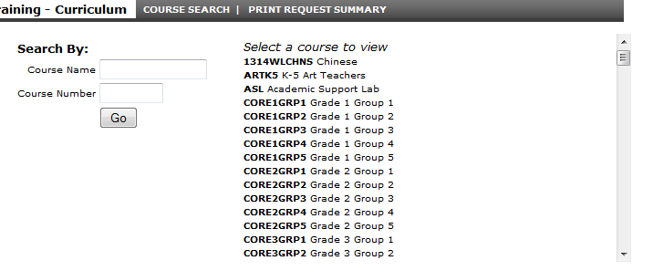
COURSE OPTIONS NAVIGATION
Students that click the Go button with both fields blank will get a list of ALL available courses offered at their school.
Students must remember to use the scroll bar to navigate through the entire list.

Slide 5
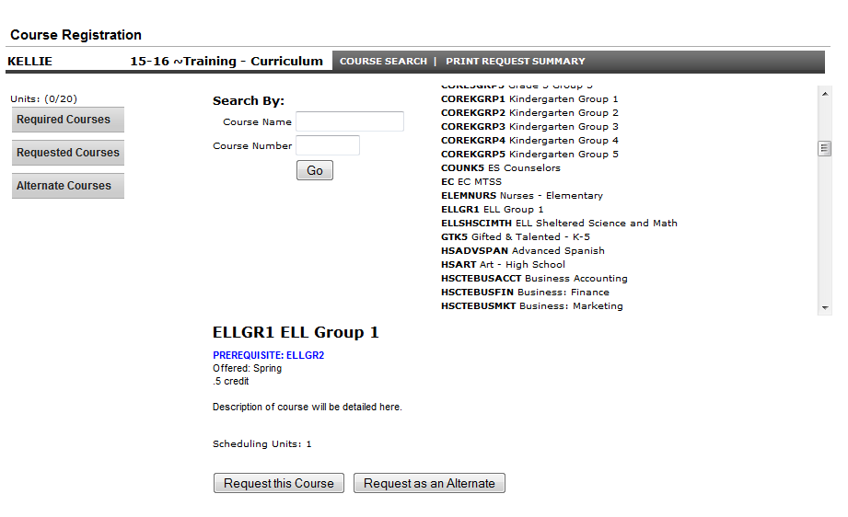
REQUESTING COURSES
Once a student clicks on the course from the course search list, additional details will populate below the search fields.
A course description, along with any prerequisites will be given. Information regarding credit amount and when the course is offered with also be provided.

Slide 6
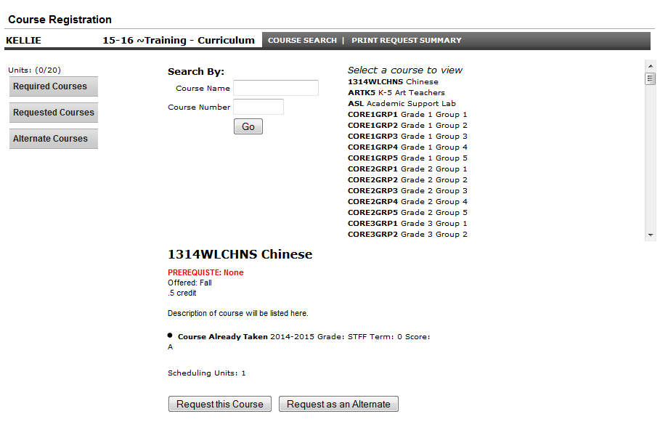
COURSE SELECTION
If a student selects a course they have already take, a warning bullet point will appear letting them know they have already taken the course.
Additionally, it will list the the year, grade, term, and score for that course.

Slide 7
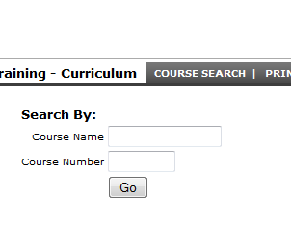
TIPS FOR COURSE SEARCHING
Once course search has been clicked, the students can search for specific courses.
Course name can be searched with a partial name entry, such as “English”.
Course number must be searched with an identical course number entry.

Slide 8
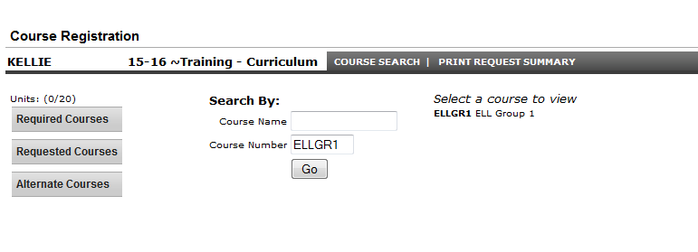
COURSE SEARCH BY NUMBER
If a student searches for a specific course number, it must be EXACTLY the course number.
In this example search, the course number is ELLGR1.
If the student was to search by just ELL, the search results (Select a course to view) would be blank.

Slide 9
COURSE SEARCH BY NAME
If a student searches for a specific course name, it can contain just part of the course name.
In this example search, the course number is ELLGR1. If the student was to search by just ELL, the search results (Select a course to view) would be contain all courses that contain ELL.
If the student searches for the exact course name, it will just bring up that specific course.

Slide 10
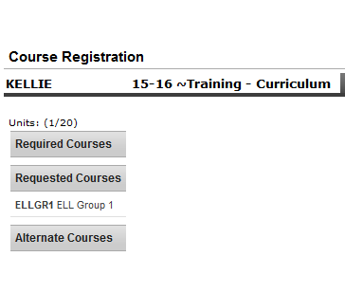
ADDING REQUESTS
As students request a course, that course will appear in the list to the left under the Requested Courses section.
Students will continue to click on course search and search for each course individually until they have selected the appropriate number of courses and the appropriate number of alternate courses.

Slide 11
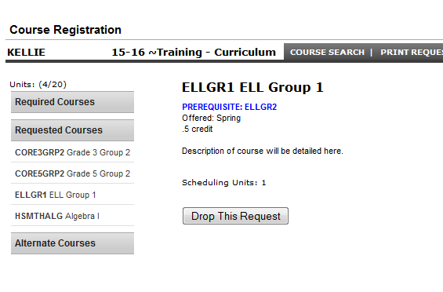
DROPPING REQUESTS
Students may wish to drop a request during the initial selection of courses due to an error or request change.
Students can drop the request by clicking on the course under the request courses section on the left.
Once they click on the course, a button will appear that will allow them to drop the request.

Slide 12
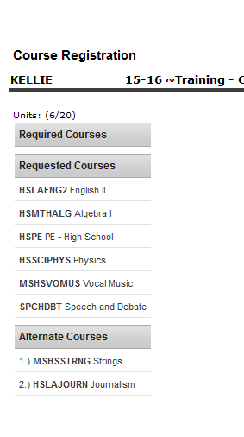
ALTERNATE REQUESTS
Students should select alternate courses.
These selections will help when meeting with school personnel regarding course availability.
If all requested courses can be scheduled, the alternate course requests will be dropped by school personnel.

Slide 13
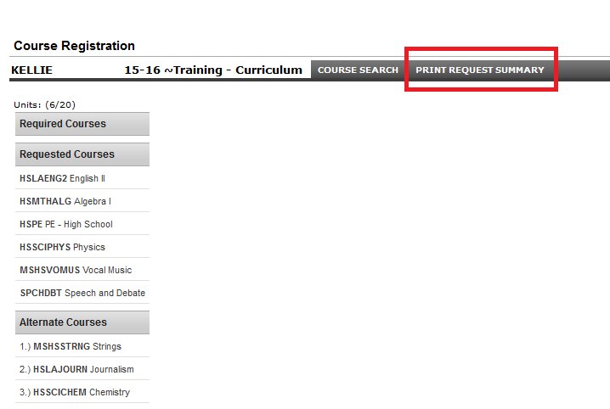
FINAL STEPS
Once students have completed course selection, they should click on the print request summary button.

Slide 14
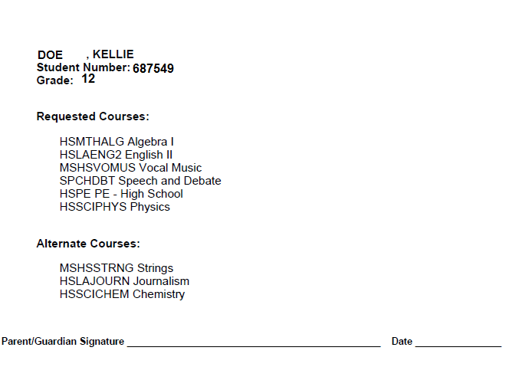
FINAL STEPS
Students should retain this summary sheet as confirmation that the process was completed.

