Slide 1
What does my academic plan ACTUALLY mean?

Slide 2
Your counselors are…
Ms. Haylett
Ms. Miller
Ms. Fahey
Mr. Williamson
We are here to help you so stop by and see us if you have any questions

Slide 3
What is a credit?
A credit is the value that is earned when you PASS a class.
You earn .5 credits per class WHEN you pass.
PASSING = an A, B, C, or D.
PASSING SRG class = 1.5 or higher.
F = 0.0 credits

Slide 4
GPA-SRG
Each grade that you earn is worth a numerical value.
Grade Point Average (GPA) is the average of the grades you have earned.
SRG | Grade | GPA
3.0-4.0 | A | 4.0
2.5-2.99 | B | 3.0
2.0-2.4 | C | 2.0
1.5-1.99 | D | 1.0
0-1.49 | F | 0.0

Slide 5
What is a transcript?
Official record of your entire high school career.
What is on it?
  Attendance: absences, tardies
  Enrollment: how many schools you attended K-12
  GPA, Class Rank
  Courses Attempted, Grades, Drops
  Test Scores (Iowa Assessments, ACT, PSAT, SAT, etc)

Slide 6
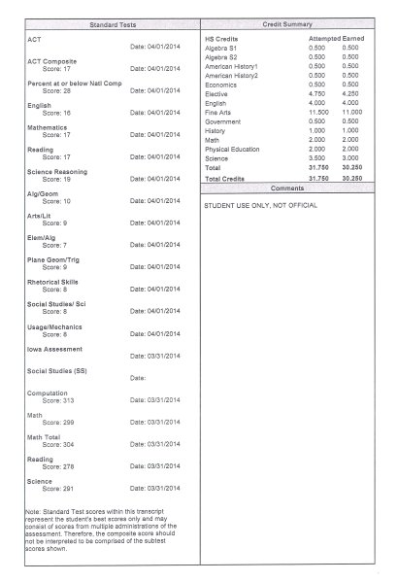
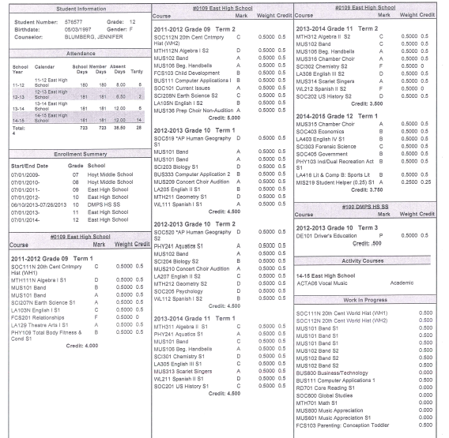
Sample Transcript…

Slide 7
How do I graduate?
Total Credits for High Graduation
Total Credits for College
English = 4.0
Social Science = 3.0
Math = 3.0
Science = 3.0
Fine Arts = 1.5
PE (CPR) = 1.0
Elective = 7.5
21st Century Skills
Total Credits Needed = 23
English = 4.0
Social Science = 3.0
Math = 3.0
Science = 3.0
Fine Arts = 1.0
PE = 1.0
Elective = 7.0
World Language = 2.0
Total Credits Needed = 24.5

Slide 8
Typical Freshman Core Courses
Primary Core
English I
20th Century World History
Biology
Algebra I
Alternatives
Earth Science/Conceptual Physics
Geometry/Algebra II

Slide 9
21st Century Skills
Required to graduate.
4 Catagories
  Health Literacy
  Financial Literacy
  Employability
  Technology
  Many classes count for each of these catagories. In the course catalog, 21st Century Skill courses will be identified.
  BUS219: Health and Financial Literacy meets 3 out of 4 and is the best choice.
  Your counselor will work with you to ensure you have met these requirements over the next four years.

Slide 10
Electives for 9th Graders
(Year Long Electives)
Woodworking
Metalworking
Construction
3D Mechanical/Architectural Design
Introduction to Engineering (PLTW)
Theatre
Sewing
Intro 2D and 3D Art
Mass Media
Nutrition and Food Prep I & II
Choir, Band, Orchestra
Intro to Debate
AP Music Theory

Slide 11
Electives for 9th Graders
(Semester Long Electives)
Parenting (concpt-tod & preschl-adolesc)
Studio Music Production
College Personal Finance
Journalism
History’s Mysteries
Speech
Health & Financial Literacy
Computer Applications
Marketing
International Business
College Desktop Publishing
Business Law
America in the ‘60s

Slide 12
World Languages
Roosevelt
French I
French II
French III
Spanish I
Spanish II
Spanish III
AP Spanish IV
AP Spanish V
Heritage Spanish
Central
Upper level French (IV+)
German
Italian
Chinese*
Japanese*
Arabic*
*Students much be proficient on IA Assessments and passing English with a C or higher to be considered for the course.

Slide 13
Central Campus
Broadcasting & Film Commercial Photography Graphic Communications Army JROTC* Early Childhood Careers Teacher Academy Urban Leadership* Animal Science & Horticulture Marine Biology Aquarium Science Energy & Sustainability Advanced Nurse Aide Health Science Specialist Anatomy & Physiology *available to 9th grade students
Automotive Collision
Automotive Technology
Home Building
Painting and Drywall
CADD
Engineering, Robotics, & Electronics
Project Lead the Way
-Digital Electronics
-Civil Engineering & Architecture
Computer Technology & Networking
Mobile Apps
Culinary Arts
Fashion Design & Merchandising

Slide 14
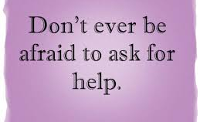
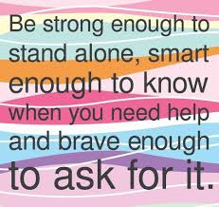
If you learn nothing else, at least learn this….

Slide 15
Common Questions
What happens if I fail a class?
  If you fail a core class (English, math, science, history) you will need to retake the class in order to earn credit towards graduation.
  If you fail an elective or fine arts class (Intro to Art, Spanish, Woodworking), you may not have to retake that specific class BUT you still need to earn the required credits (7.5 electives, 1.5 fine arts).
Can a student graduate with 24 credits and no PE?
  No, you cannot. State Law.
What if I have met all of my graduation requirements as a Junior?
  You may be eligible to graduate early. Please see your counselor if you have questions.

Slide 16
Questions…
REMEMBER:
When completing your Course Request Sheet:
these are REQUESTS, not a guarantee!
July 1st – schedules will be visible in Infinite Campus.
Please Note: adjustments may be made to schedules up until the day before school starts. Be sure to check your schedule the night before school starts to confirm!

Slide 17
Freshman Orientation
August 1st & 2nd, 2016
At Roosevelt High School
A mailing will be sent to your address in Infinite Campus. Please make sure your information is up to date!
During orientation, your student will get tours of the building, learn more about Roosevelt High School, get their student ID, and connect with their Rider Crew leader!
See you in August!

Slide 18
Stacey Haylett - 9/10 stacey.haylett@dmschools.org
Haylie Miller – 9/10 haylie.miller@dmschools.org
Ryan Williamson – 11/12 ryan.Williamson@dmschools.org
Contact us….

